Slide 1
Exploring Relationships In Air Quality and Hummingbird Species Distribution in California
Sierra Harris
Catherine Aznoe
Cristina Lefemine

Slide 2
“Quote that relates to project”
Name of Quotee

Slide 3

Project Vision
eBird Observations
California
10 Humming-bird Species

Slide 4

Data Exploration
What drives hummingbirds to be at the observed locations?

Slide 5
What environmental factors play a role?
Does air quality impact hummingbird populations in California?
Is there a relationship between air quality and hummingbird species distribution and resilience throughout California?
Does poor air quality have an impact on resources hummingbirds rely on for survival?
Do microclimates throughout California impact the fitness of hummingbird habitats at different times of the year?

Slide 6
What about other factors?

Slide 7
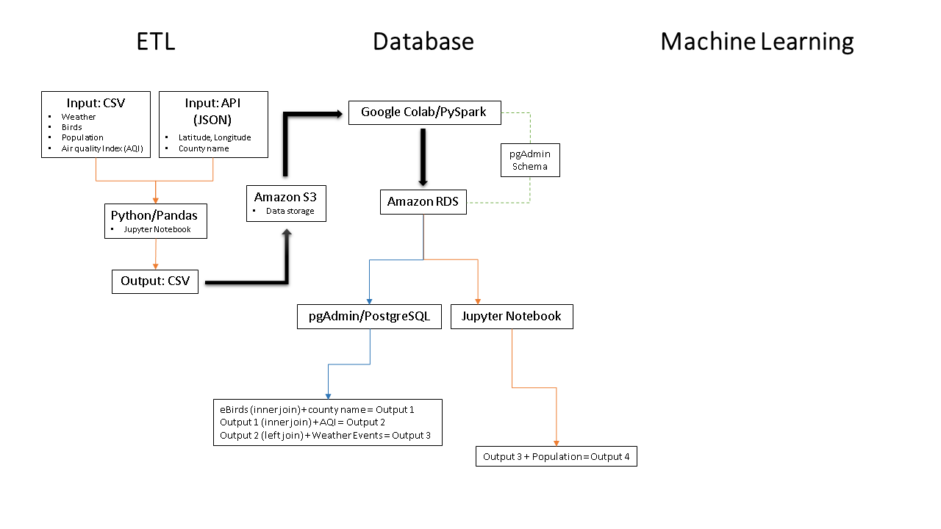
Notes:
Will transfer actual diagram, rather than copy of image, once diagram is complete.

Slide 8
Machine Learning
Data Processing
Y value → bird species
Model Choice
Supervised
Accuracy Scores
Training → 0.7191009160217761
X value → features
Logistic Regression
Training & Testing Sets
Clean the data
Joins → pgAdmin
Merge → Pandas
Features
Primary focus
Correlation matrix
Number of features
Conceptual relationships
Testing → 0.7201529652327877
Notes:
Include that we are doing supervised machine learning models because we are classifying the data and seeing the prediction of hummingbirds being present.
We’re not using SQLAlchemy to import data, just pandas sql.

Slide 9
Challenges
Large datasets
47 million
⭣
1.3 million
Location data
Lat/Long
Vs
County Name
RDS
Defaulted to Mumbai

Slide 10
Future Analysis
Obtain and add bird observation data from more resources, i.e., U.S. Fish & Wildlife Service
Expand analysis to more bird species and/or locations.

Slide 11
Anything you’d do Differently?
???

Slide 12
Citations
Global Biodiversity Information Facility, Citation GBIF.org (10 October 2020) GBIF Occurrence Download https://doi.org/10.15468/dl.2rhbnh
Global Biodiversity Information Facility, Citation GBIF.org (10 October 2020) GBIF Occurrence Download https://doi.org/10.15468/dl.fsvwgj
Environmental Protection Agency, Daily Summaries, https://aqs.epa.gov/aqsweb/airdata/download_files.html#Daily
National Oceanic and Atmospheric Administration, Storm Events Database, https://www.ncdc.noaa.gov/stormevents/choosedates.jsp?statefips=6%2CCALIFORNIA#
Federal Communication Commission (FCC), Census Block for Developers, https://geo.fcc.gov/api/census/#!/block/get_block_find
California Association of Counties, Data and Research, https://www.counties.org/data-and-research

Slide 13

Questions?

